Slide 1
Analyzing the Impact of Climate Change on Global Crop Production using power BI
A Data-Driven study Using the Crop Production Index (1961-2022)

Slide 2
Indroduction
Agriculture is the backbone of many economies, providing food security and employment. However, climate change is disrupting crop production, leading to fluctuations in food supply and economic instability. This project analyzes global crop production trends using the World Bank’s Crop Production Index (2014-2016 = 100) to understand how climate variability affects agricultural output.
By leveraging Power BI, we create an interactive dashboard that allows policymakers, researchers, and stakeholders to explore trends, identify patterns, and make data-driven decisions for a more sustainable future.

Slide 3
Objectives
The primary objectives of this project are:
Analyze historical crop production trends from 1961-2022 for different countries and regions.
Identify patterns and anomalies in global and regional crop production.
Assess the impact of climate variability on agricultural output.
Compare crop production growth rates across different decades.
Use Power BI to build an interactive dashboard with key insights and visual

Slide 4
Data Collection & Processing
Dataset Description:
Source: World Bank Open Data
Time Period: 1961 - 2022
Variables:
Country Name & Code: Unique identifiers for each country.
Yearly Crop Production Index: Measures agricultural output relative to the base period (2014-2016 = 100).
Region & Economic Classification: Groups countries based on geographic & income categories.

Slide 5
Data Cleaning & Transformation (Power BI - Power Query)
1. Removed Unnecessary Columns and rename (e.g., metadata, empty columns).
2. Unpivoted Year Columns (Converted wide format to long format).
3. Handled Missing Values (Replaced null values with interpolated data or baseline of 100).
4. Changed Data Types (Ensured Year = Whole Number, Crop Production Index = Decimal).
5. Merged Metadata (Combined additional country information for regional analysis).

Slide 6
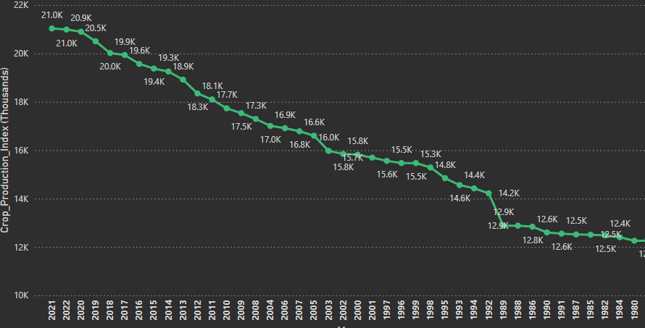
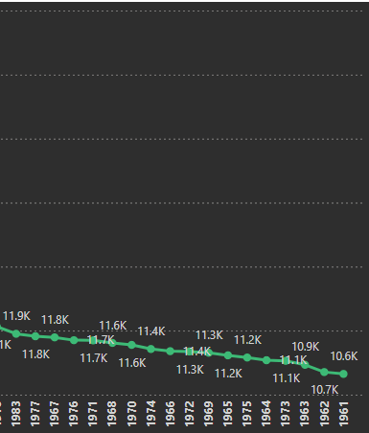
Power BI Dashboard & Visualizations
1. Global Crop Production Trends (Line Chart)
Purpose: Show historical changes in crop production from 1961-2022.
Findings:
This indicates a Steady upward trend in global production over the past 60 years.
Sharp spikes in the 1980s and 2000s (due to technological & policy advancements).
1961 - 1980: Moderate increase, reaching around 12K - 15K.
1980 - 2000: Faster growth, exceeding 18K.
2000 - 2021: Significant rise, reaching 21K in 2021.

Slide 7
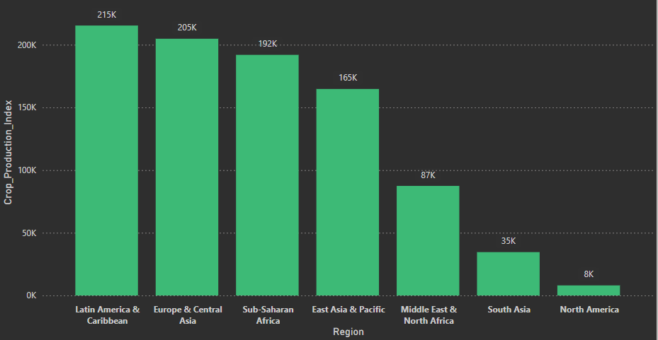
2.Regional Crop Production Trends
Findings:
This bar chart represents crop production index across different global regions.
Highest Production Regions: Latin America & Caribbean, Europe & Central Asia, Sub-Saharan Africa, and East Asia & Pacific produce the most, mainly due to factors like fertile land, large-scale farming, and advanced agricultural technologies.
Moderate Production Region: Middle East & North Africa show moderate production levels, likely because arid climates and limited water resources restrict crop yields.
Lowest Production Regions: South Asia and North America have the lowest production values in this dataset, possibly due to limited arable land, data representation issues, or resource constraints.
Key Takeaway: These findings help us understand where agricultural productivity is strongest and highlight regions that may face challenges, suggesting a need for targeted support or policy interventions.

Slide 8
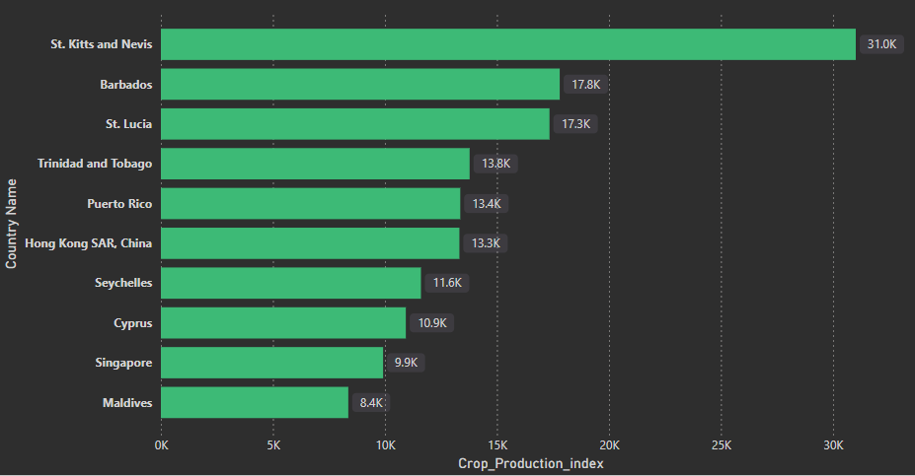
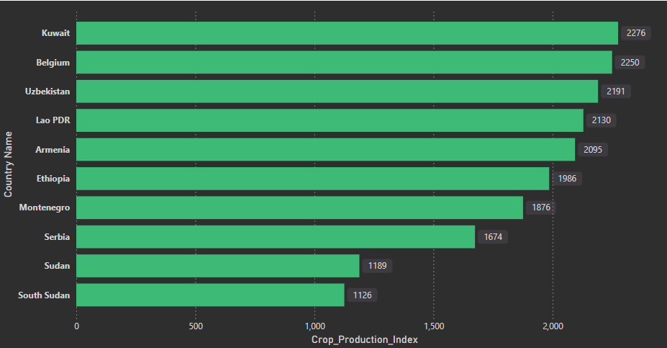
3.Top and Bottom Countries by Crop Production Index
Top Crop Production Countries: St. Kitts and Nevis, Barbados, St. Lucia, Trinidad and Tobago, Puerto Rico, Hong Kong, Seychelles, Cyprus, Singapore, and Maldives have the highest crop production index. Reasons include favorable climate, efficient irrigation, and advanced agricultural practices.
Bottom Crop Production Countries Kuwait, Belgium, Uzbekistan, Laos, Armenia, Ethiopia, Montenegro, Serbia, Sudan, and South Sudan have the lowest crop production index. Reasons include limited arable land, urbanization, and dependency on food imports.

Slide 9
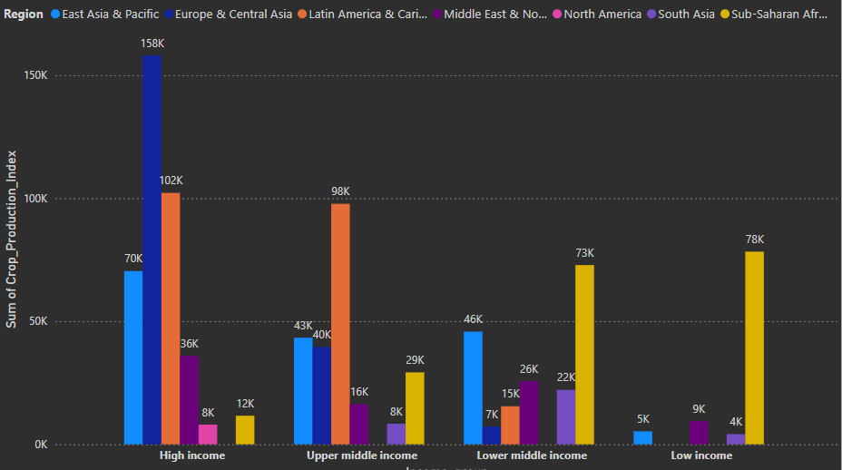
4.Crop production by region &Income
Europe & Central Asia has the highest crop production among high-income countries (158K).
Latin America & Caribbean follows closely with 102K in the high-income group.
Latin America & Caribbean leads in the upper middle-income group (98K).
Sub-Saharan Africa dominates both the low-income (78K) and lower middle-income (73K) groups.
East Asia & Pacific contributes significantly to high-income (70K) and lower middle-income (46K) groups.
North America has a moderate crop production in the high-income group (8k).

Slide 10
Suggestions
• The crop production index time period on 1961 to 2022. The production value in 1961 is around 30k and gradually increases in the years .at last the crop production value in 2022 around 52k.This means crop production index
increases over the years.
• The modern systems have given great importance.
• Utilize technologies like GPS , sensors ,and analytics to optimize inputs (water ,fertilizer ,pesticides) and improve
efficiency . This can lead to higher yields and reduced costs.
• Invest in soil health. It means Implement practices like cover cropping, crop rotation, and no-till farming to improve soil
fertility, water retention, and overall productivity.
• Diversify crops: Reduce reliance on monocultures and incorporate a wider range of crops, including high-value ones,
to increase income potential and resilience to pests and diseases.
• Improve pest and disease management: The Implement integrated pest management strategies that combine cultural,
biological, and chemical methods to minimize losses and environmental impact.
• Explore value-added activities to Consider processing or packaging crops to increase their value and access new
markets.
• Enhance market access: Participate in farmers' markets, cooperatives, or direct marketing initiatives to reach
consumers and potentially obtain better prices.

Slide 11
Conclusion
Increasing crop production value is crucial for ensuring food security, supporting farmers' livelihoods, and driving economic growth. By focusing on sustainable practices, technological advancements, and market-oriented strategies, farmers, policymakers, and researchers can work together to enhance crop production value while preserving natural resources and promoting long-term agricultural sustainability

